Slide 1
Lecture 9.1 – Virtualisation Professor Richard O. Sinnott Director, eResearch University of Melbourne rsinnott@unimelb.edu.au

Slide 2
Overview
Virtualisation
What happens in a VM?
Motivation & History
What are the requirements for virtualisation?
Virtualisation approaches
Memory management
Live migration

Slide 3
Terminology
Virtual Machine Monitor/Hypervisor: The virtualisation layer between the underlying hardware (e.g. the physical server) and the virtual machines and guest operating systems it supports.
The environment of the VM should appear to be the same as the physical machine
Minor decrease in performance only
Appears as though in control of system resources
Virtual Machine: A representation of a real machine using hardware/software that can host a guest operating system
Guest Operating System: An operating system that runs in a virtual machine environment that would otherwise run directly on a separate physical system
Hardware
VMM/Hypervisor
VM
VM
Guest
Guest

Slide 4
Recap on Kernel-User mode separation
User Space
Process 1
Process 2
Process N
Context switch
Context switch
Kernel Space
Operating System Kernel
Processes run in lower privileged (user) mode
OS Kernel runs in privileged Kernel mode
OS typically virtualises memory, CPU, disk etc giving appearance of complete access to CPU/memory/disk to application processes
Each process has illusion of access to some/all of the memory or the CPU (but actually shared across multiple processes)
Context switches can catch (trap) “sensitive” calls
e.g. add two numbers vs change bios settings;
Sensitive calls -> instruction sets are typically device specific, e.g. ARM vs x86 vs …

Slide 5
What Happens in a VM?
VMM/Hypervisor
Gives perception of a whole machine
VM
Guest OS
Host Network Device
VHD (Virtual Hard Disk represents a virtual hard disk drive (HDD). May contain what is found on a physical hard disk, such as disk partitions and a file system, which in turn can contain files and folders.
Virtual Network Device
Host hard drive
Image file on disk (vmdk, vhd, qcow2 etc)
VMDK (Virtual Machine Disk) describes containers for virtual hard disk drives to be used in virtual machines like VMware.
Virtual Disk
qcow2 (QEMU Copy On Write) file format for disk image files used by QEMU. It uses a disk storage optimization strategy that delays allocation of storage until it is actually needed.
Guest OS apps “think” they write to hard disk but translated to virtualised host hard drive by VMM
Which one is determined by image that is launched

Slide 6
Motivation
Server Consolidation
Increased utilisation
Reduced energy consumption
Personal virtual machines can be created on demand
No hardware purchase needed
Public cloud computing
Security/Isolation
Share a single machine with multiple users
Hardware independence
Relocate to different hardware

Slide 7
History
Virtualisation concept goes back to 1960s
IBM System/370
System/370 featured hardware support for interpretive execution
Formal requirements laid down by Popek and Goldberg (1974)
Why then?
Mainframes needed ability to run multiple kinds of applications
Hardware was very expensive “back in the day”
Notes:
While full compliance with Popek and Goldberg requirements would render a running guests incapable of determining that it is executing within a virtual machine, in reality, timing effects and other quirks can be used to determine this.
The introduction of AMD-V and Intel VT-x allowed x86 architectures to meet Popek and Goldeberg virtualisation requirements. Prior to that, binary translation was required [see Robin and Irvine (2000) and Adams and Agesen (2006) ]

Slide 8
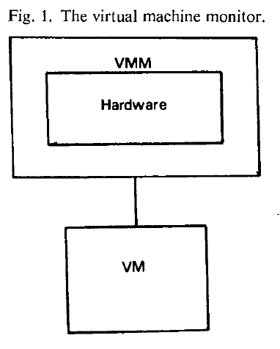
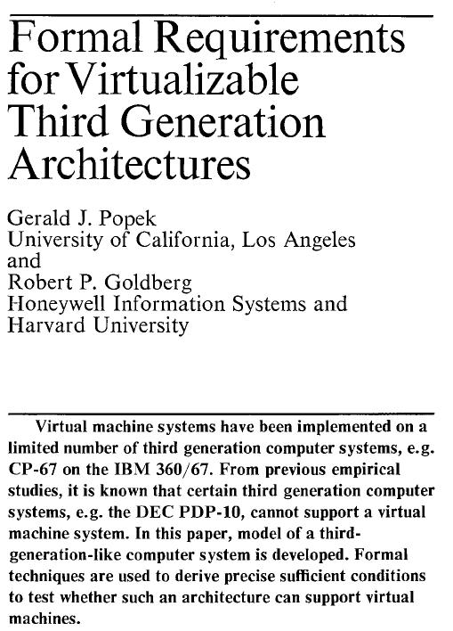
Origins - Principles
“an efficient, isolated duplicate of the real machine”
Properties of interest
Fidelity: Software on the VMM executes behaviour identical to that demonstrated when running on the machine directly, barring timing effects
Performance: An overwhelming majority of guest instructions executed by hardware without VMM intervention
Safety: The VMM manages all hardware resources
Communications of the ACM, vol 17, no 7, 1974, pp.412-421
Notes:
While full compliance with Popek and Goldberg requirements would render a running guests incapable of determining that it is executing within a virtual machine, in reality, timing effects and other quirks can be used to determine this.
The introduction of AMD-V and Intel VT-x allowed x86 architectures to meet Popek and Goldeberg virtualisation requirements. Prior to that, binary translation was required [see Robin and Irvine (2000) and Adams and Agesen (2006) ]

Slide 9
Classification of Instructions
Privileged Instructions: instructions that trap if the processor is in user mode and do not trap in kernel mode
Sensitive Instructions: instructions whose behaviour depends on the mode or configuration of the hardware
Different behaviours depending on whether in user or kernel mode
e.g. POPF interrupt (for interrupt flag handling)
Innocuous Instructions: instructions that are neither privileged nor sensitive
Read data, add numbers etc
Notes:
While full compliance with Popek and Goldberg requirements would render a running guests incapable of determining that it is executing within a virtual machine, in reality, timing effects and other quirks can be used to determine this.
The introduction of AMD-V and Intel VT-x allowed x86 architectures to meet Popek and Goldeberg virtualisation requirements. Prior to that, binary translation was required [see Robin and Irvine (2000) and Adams and Agesen (2006) ]

Slide 10
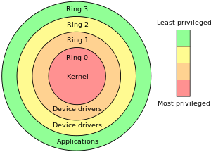
Origins - Principles
Theorem (Popek and Goldberg)
For any conventional third generation computer, a virtual machine monitor may be constructed if the set of sensitive instructions for that computer is a subset of the set of privileged instructions
i.e. have to be trappable
Significance
The IA-32/x86 architecture was not originally virtualisable
Example of Privilege Rings
Ring 0: Typically hardware interactions
Ring 1: Typically device drivers
Specific gates between Rings (not ad hoc)
Allows to ensure for example that spyware can’t turn on web cam or recording device etc

Slide 11
x86 Virtualisability
x86 architecture was historically not virtualisable, due to sensitive instructions that could not be trapped, e.g. instructions such as:
SMSW – storing machine status word
SGDT, SLDT – store global/local descriptor table register
POPF – interrupt flag (user/kernel mode)
Robin and Irvine, Analysis of an Intel Pentium’s Ability to Support a Secure Virtual Machine Monitor, Usenix, 2000
Intel and AMD introduced extensions to make x86 virtualisable
AMD SVM (Secure Virtual Machine)
Intel VT (Virtualisation Technology)
These two are very similar, but use slightly different machine instructions

Slide 12
Typical Virtualisation Strategy
VMM needs to support:
De-privileging
VMM emulates the effect on system/hardware resources of privileged instructions whose execution traps into the VMM
aka trap-and-emulate
Typically achieved by running GuestOS at a lower hardware priority level than the VMM
Problematic on some architectures where privileged instructions do not trap when executed at de-privileged level
Primary/shadow structures
VMM maintains “shadow” copies of critical structures whose “primary” versions are manipulated by the GuestOS, e.g. memory page tables
Primary copies needed to insure correct versions are visible to GuestOS
Memory traces
Controlling access to memory so that the shadow and primary structure remain coherent
Common strategy: write-protect primary copies so that update operations cause page faults which can be caught, interpreted, and addressed
Someones app/code doesn’t crash the server you are using!!!
Trap and Emulate!
GuestOS
privileged
instruction
trap
resource
emulate change
vmm
change
resource

Slide 13
Major VMM and Hypervisor Providers
VMM Provider | Host CPU | Guest CPU | Host OS | Guest OS | VM Architecture
VMWare Workstation | x86, x86-64 | x86, x86-64 | Windows, Linux | Windows, Linux, Solaris, FreeBSD, OS/2 | Full Virtualization
VMWare ESX Server | x86, x86-64 | x86, x86-64 | No Host OS | Same as VMWare workstation | Baremetal hypervisor
Xen | x86, x86-64, IA-64 | x86, x86-64, IA-64 | NetBSD, Linux, Solaris | Windows, Linux, Solaris, FreeBSD, OS/2, NetBSD | Para-virtualisation
KVM |  |  | Linux | Linux, Windows, FreeBSD, Solaris | Hardware virtualisation

Slide 14
Aspects of VMMs
Full virtualisation – allow an unmodified guest OS to run in isolation by simulating full hardware (e.g. VMWare)
Guest OS has no idea it is not on physical machine
vs
Para-virtualisation – VMM/Hypervisor exposes special interface to guest OS for better performance. Requires a modified/hypervisor-aware Guest OS (e.g. Xen)
Can optimise systems to use this interface since not all instructions need to be trapped/dealt with

Slide 15
Full Virtualisation
Advantages
Guest is unaware it is executing within a VM
Guest OS need not be modified
No hardware or OS assistance required
Can run legacy OS
Disadvantages
can be less efficient
Direct execution of code
Ring 3
User Apps
Ring 2
User/kernel split typically
VMM run Ring 0
Apps run in Ring 3
Virtualisation (Guest OS) uses extra rings; VMM traps privileged instructions and translates to hardware specific instructions
Ring 1
Guest OS
Binary translation of OS privileged
Ring 0
VMM
Host Hardware

Slide 16
Para-Virtualisation
Advantages
Lower virtualisation overheads, so better performance, e.g. Xen
Disadvantages
Need to modify guest OS
Can’t run arbitrary OS!
Less portable
Less compatibility
Direct execution of code
Ring 3
User Apps
Ring 2
Calls to virtualisation layer replace non-virtualisable instructions
Ring 1
Ring 0
Paravirtualised Guest
VMM
Host Hardware

Slide 17
Aspects of VMMs (contd…)
Hardware-assisted virtualisation – Hardware provides architectural support for running a Hypervisor (e.g. KVM)
New processors typically have this
Requires that all sensitive instructions trappable
vs
Binary Translation – Trap and execute occurs by scanning guest instruction stream and replacing sensitive instructions with emulated code (e.g. VMWare)
Don’t need hardware support, but can be much harder to achieve
Rarely ever 1:1 mapping between instruction sets

Slide 18
Hardware-assisted virtualisation
Advantages
Good performance
Easier to implement
Advanced implementation supports hardware assisted DMA, memory virtualisation, …
Disadvantages
Needs hardware support
Direct execution of code
Ring 3
User Apps
Ring 2
Calls to virtualisation layer replace non-virtualisable instructions
Ring 1
Ring 0
Guest OS
New Ring -1 supported
Page tables, virtual memory mgt, direct memory access for high speed reads etc
VMM
Ring -1
Host Hardware

Slide 19
Binary Translation
Advantages
Guest OS need not be modified
No hardware or OS assistance required
Can run legacy OS
Disadvantages
Overheads
Complicated
Need to replace instructions “on-the-fly”
Library support to help this, e.g. vCUDA
Direct execution of code
Ring 3
User Apps
Ring 2
Ring 1
Guest OS
Binary translation of OS privileged
Ring 0
VMM
Host Hardware

Slide 20
Aspects of VMMs (contd…)
Bare Metal Hypervisor – VMM runs directly on actual hardware (e.g. VMWare ESX Server)
Boots up and runs on actual physical machine
VMM has to support device drivers, all HW mgt
vs
Hosted Virtualisation – VMM runs on top of another operating system (E.g. VMWare Workstation,…)

Slide 21
Operating System Level Virtualisation
Lightweight VMs
Instead of whole-system virtualisation, the OS creates mini-containers
A subset of the OS is often good enough for many use cases
Can’t use for running Windows on Linux etc, but often not needed!
Akin to an advanced version of “chroot”
operation that changes apparent root directory for current running process and subprocesses. Program run in such a modified environment cannot access files and commands outside that environmental directory tree. Aka a chroot jail
Examples:
LXC, Docker, OpenVZ, FreeBSD Jails etc

Slide 22
Operating System Level Virtualisation
Advantages
Lightweight
Many more VMs on same hardware
Can be used to package applications and all OS dependencies into container
Disadvantages
Can only run apps designed for the same OS
Cannot host a different guest OS
Can only use native file systems
Uses same resources as other containers

Slide 23
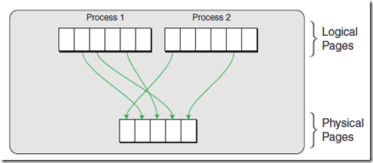
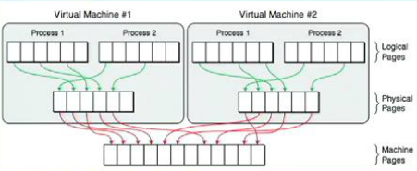
Memory Virtualisation
Conventionally page tables store the logical page number -> physical page number mappings
Seems like more memory than actually have
What happens in a VM?

Slide 24
Shadow Page Tables
VMM
machine
OS
physical
VMM maintains shadow page tables in lock-step with the page tables
Adds additional management overhead
Hardware performs guest -> physical and physical -> machine translation
process
virtual
Shadow Page Table Entry
VMM
GuestOS
“shadow” page tables
page tables
Notes:
Normal scenario: virtual -> physical mapping
Software MMU:
VMM stores PPN->MPN mappings in its internal data structures
And stores LPN->MPN mappings in shadow page tables that are exposed to hardware.
VMM keeps shadow page tables synchronised with guest page tables
Virtualised scenario: virtual -> physical -> machine mapping
Hardware assisted: virtual -> machine mapping via hardware maintained shadow page table

Slide 25
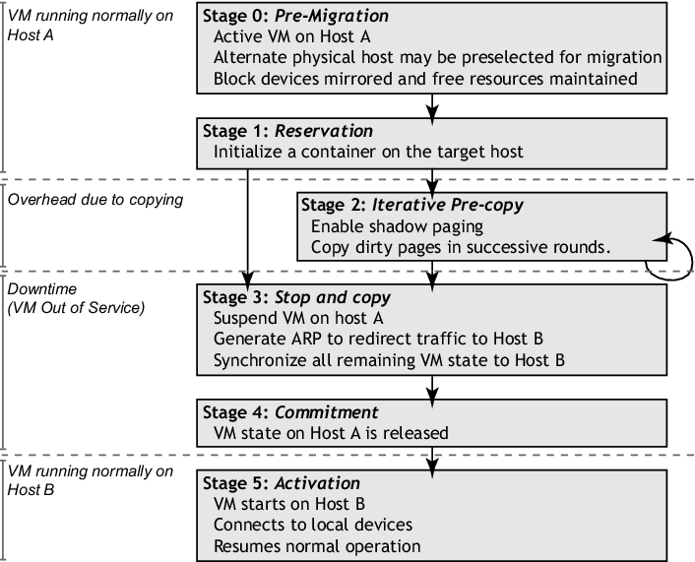
Live Migration from Virtualisation Perspective
Source: Clark et al, Live migration of virtual machines, NSDI 2005
Clark et al. Live migration of virtual machines, NSDI 2005.
Notes:
General design of memory migration:
Push phase - The source VM continues running while certain pages are pushed across the network to the new
destination. To ensure consistency, pages modifed during this process must be re-sent.
Stop-and-copy phase - The source VM is stopped, pages are copied across to the destination VM, then the new
VM is started.
Pull phase - The new VM executes and, if it accesses a page
that has not yet been copied, this page is faulted in
(pulled) across the network from the source VM.

Slide 26
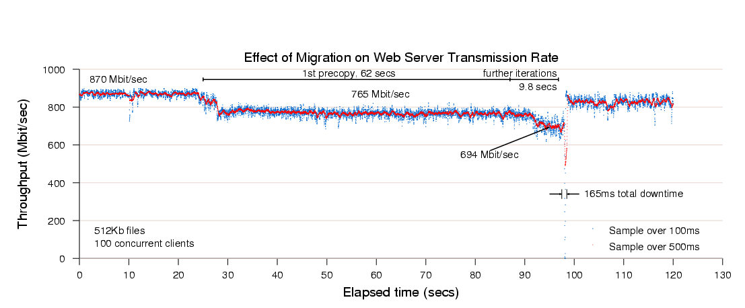
Effects of Live Migration
Source: Clark et al, Live migration of virtual machines, NSDI 2005

Slide 27
References
Hwang, Dongarra & Fox, 2011. Distributed and Cloud Computing, 1st Edition. Elsevier.
Rosenblum M & Garfinkel T. 2005. Virtual machine monitors: Current technology and future trends, in IEEE Computer.
Clark et al, 2005. Live migration of virtual machines. In Proceedings of the 2nd ACM/USENIX Symposium on Networked Systems Design and Implementation (NSDI). pp. 273-286
K. Adams, O. Agesen, 2006. A Comparison of Software and Hardware Techniques for x86 Virtualization, ASPLOS 2006

